Slide 1
Machine Learning Basics
Definitions and Interview Questions

Slide 2
What is Machine Learning?
Science and art of programming computers so that they can learn from data
The field of study that gives machines the ability to learn without being explicitly programmed

Slide 3
Why use Machine Learning?
Solving problems for which the existing solutions are not efficient and require lot of hand-tuning and long lists of ever changing rules
Complex trivial problems for which there has been no good solution identified at all
Fluctuating environments where the solution needs to adapt to ever changing data
Getting insights on problems that require dealing with large volumes in terms of data

Slide 4
What are the different types of ML Systems?
Weather they need or not need human supervision to get trained:
  Supervised
  Unsupervised
  Semi-supervised
  Reinforcement
Whether or not, they can learn incrementally on the fly:
  Online
  Batch
Weather they learn the decision boundary or the detailed patterns and properties:
  Instance based
  Model based

Slide 5
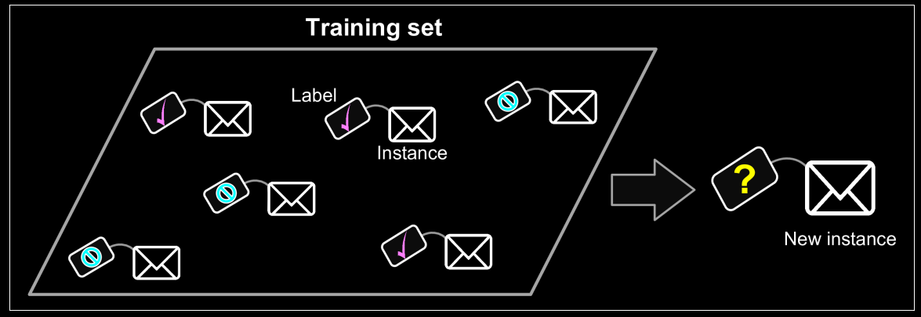
What is Supervised Learning?
The training data fed, already contains desired solutions/outcomes for instances
In other words, they are labeled (with the right/expected response):
Examples of Supervised Learning Tasks:
- K-nearest Neighbors | - Support Vector Machines (SVMs)
- Linear Regression | - Decision Trees and Random Forests
- Logistic Regression | - Neural Networks

Slide 6
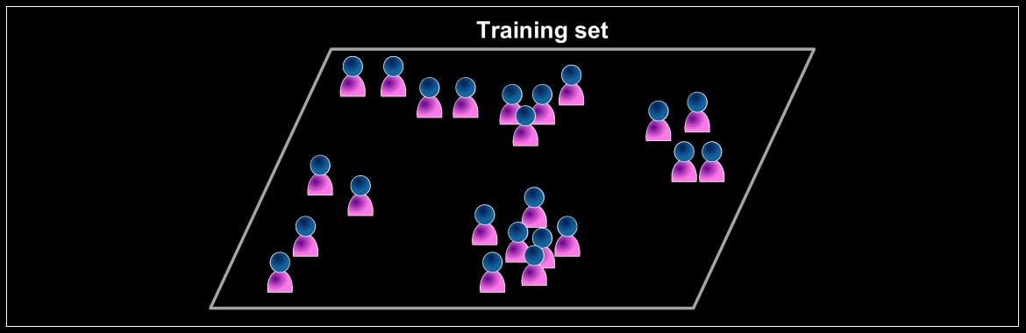
What is Unsupervised Learning?
The training data is unlabeled.
The system tries to learn without a teacher:
Examples of Unsupervised Learning Tasks:
- Clustering: K-Means, DBSCAN, Hierarchical Cluster Analysis (HCA) | - Anomaly detection and novelty detection: One-class SVM, Isolation Forest
- Visualization and dimensionality reduction: Principal Component Analysis (PCA), Kernel PCA, Locally-Linear Embedding (LLE), t-distributed Stochastic Neighbor Embedding (t-SNE) | - Association rule learning: Apriori, Eclat

Slide 7
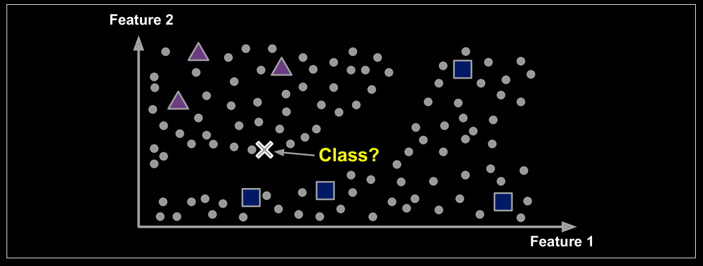
What is Semi-supervised Learning?
This involves partially labeled training data – usually a lot of unlabeled data and a little bit of labeled data:
An example of semi-supervised learning algorithm application – photo-hosting services – Google Photos
It is a combination of unsupervised and supervised algorithms.
Example: Deep Belief Networks (DBNs) – Involve stacking of multiple Restricted Boltzmann Machines (RBMs) on top of one another

Slide 8
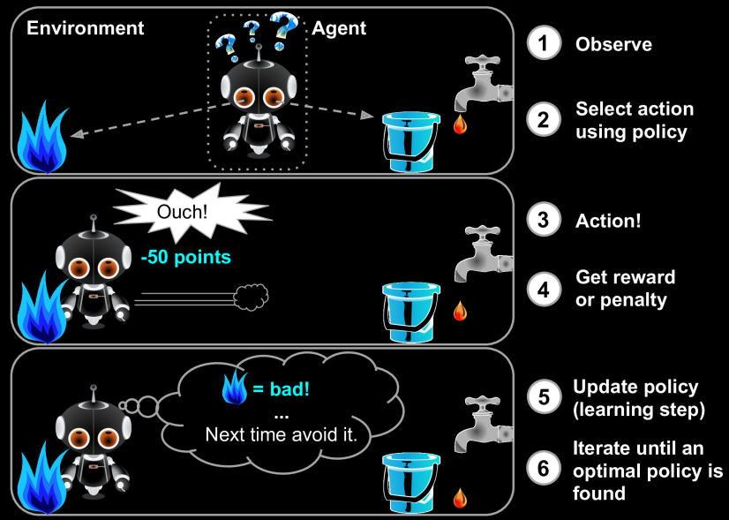
What is Reinforcement Learning?
The learning system – called an ‘agent’, observes the environment, select and perform actions and get rewards in return
It must, then learn by itself, what is the best strategy – called ‘policy’, to get most rewards over time.
Once learned, the policy defines what action the agent should choose when it is in a given situation:
An example of reinforcement learning:
Robots learning how to walk, AI based Chess, Go etc

Slide 9
What is Batch Learning?
System is incapable of learning incrementally
It must be trained on all the available data everytime (old and new, both)
Time and resource consuming process
Has a downtime – not suitable for all scenarios
‘Offline Learning’
If the system needs the ability to learn autonomously, it needs to carry all the data with it

Slide 10
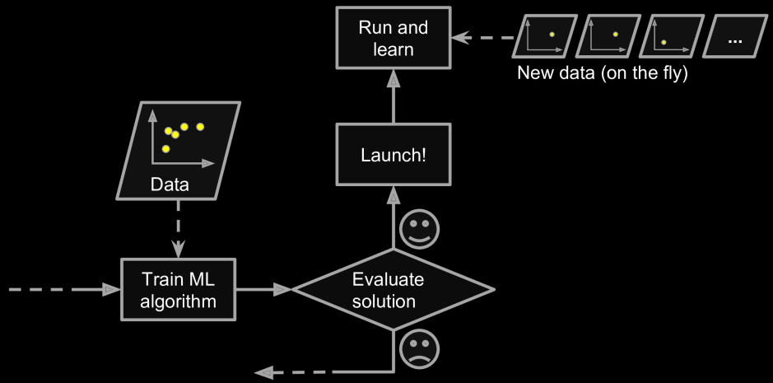
What is Online Learning?
System is trained incrementally
The data is fed sequentially either individually or in small batches
Each learning step is fast and cheap
System can learn about the new data as it arrives
Is is great for systems that receive (changing) data in continuous flow – stock price tracker
It is also a good option if we have limited computing resources
Can also be used to train systems on huge
datasets that cannot fit in machine’s RAM
Also called - ‘Out-of-core’ learning
Learning Rate – How fast the algorithm adapts
to changing data

Slide 11
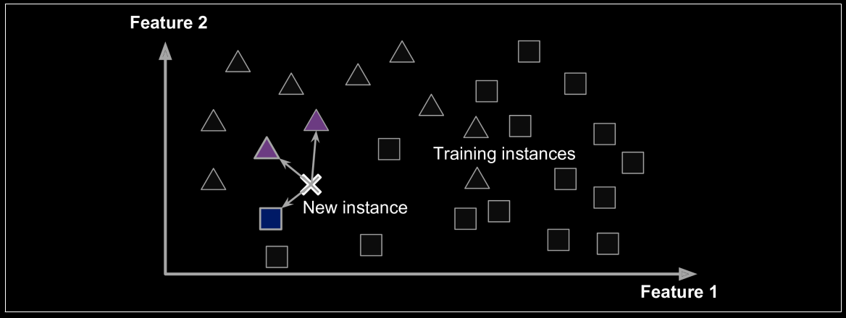
What is Instance-based Learning?
The system learns the examples (thoroughly)
Then it generalizes to new cases by comparing them to the learned examples using a similarity measure:

Slide 12
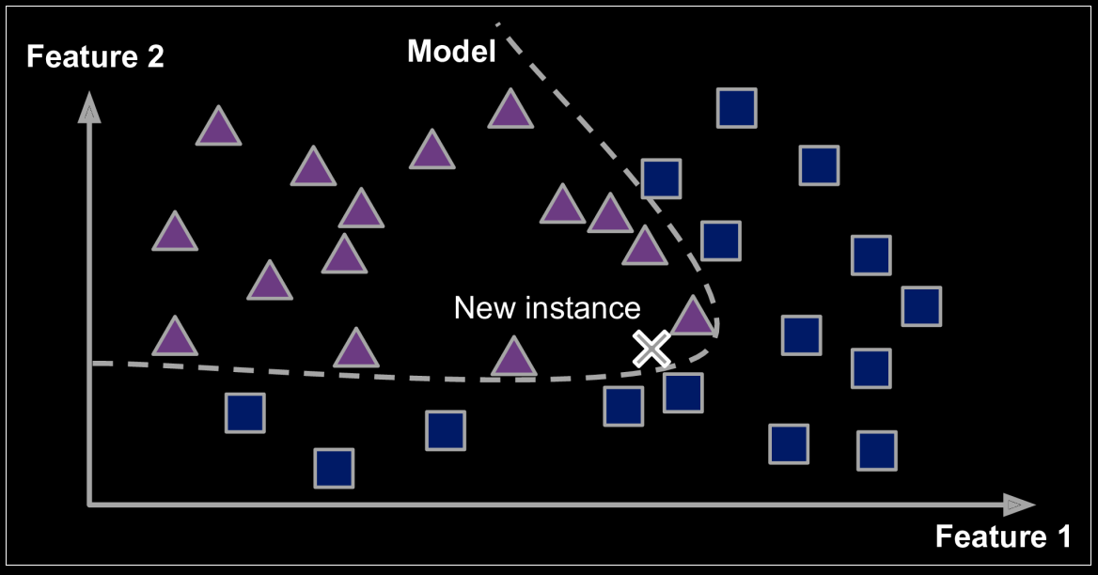
What is Model-based Learning?
Use the existing examples (training set) to build a model
Use the model to make the predictions for new data

Slide 13
What are the Main Challenges of Machine Learning?
Insufficient Quantity of Training Data
Non-representative Training Data
Poor Quality Data
Irrelevant Features
Overfitting the Training Data
Underfitting the Training Data

Slide 14
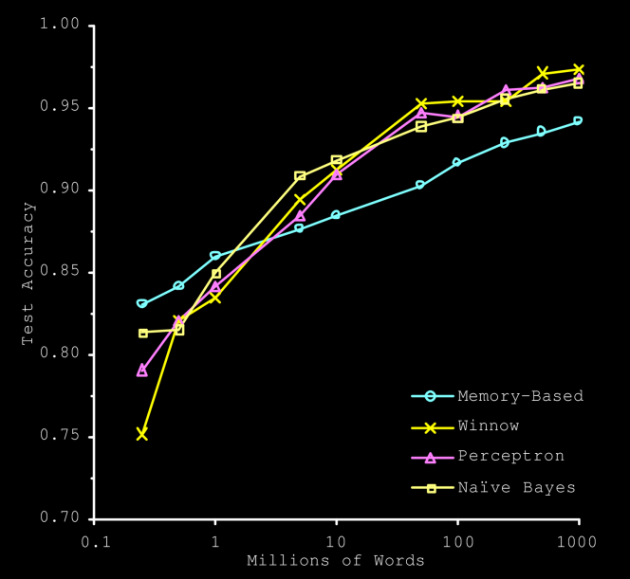
Insufficient Quantity of Training Data
It takes a lot of quality data for a Machine Learning algorithm to work as expected
Surprisingly, with enough quality data, even the fairly simple algorithms perform the same way as complex ones:

Slide 15
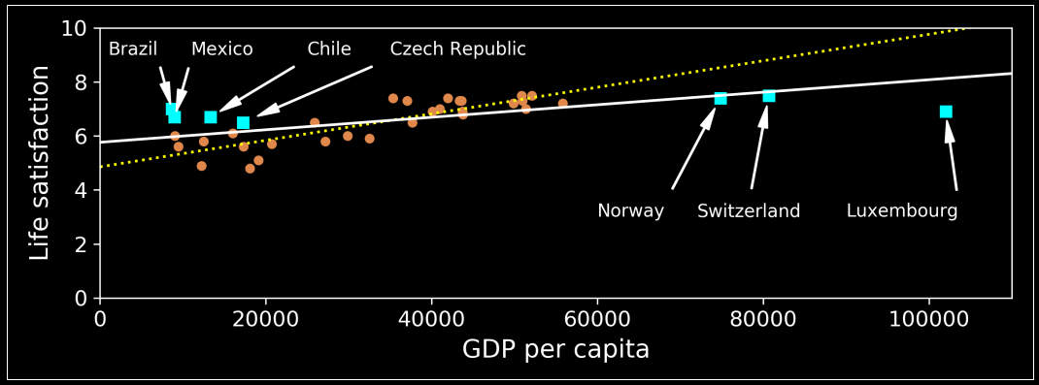
Non-representative Training Data
The training data must represent all the classes in the expected similar proportions
If that is not the case, the model may not generalize well:

Slide 16
Poor Quality Data
If the training data is full of errors, outliers and noise, it will make it difficult for the model to detect underlying patterns
Hence its worth the effort and somewhat mandatory to spend time on cleaning the data

Slide 17
Irrelevant Features
It is critical for the Machine Learning project to succeed that the training data contains only the relevant and quality features
Feature Engineering
  Feature Selection: selecting the most useful features out of the lot
  Feature Extraction: Combining the various existing features to come up with a more relevant feature. Example: Dimensionality Reduction
  Creating new features by gathering more data – high quality and relevant

Slide 18
Overfitting or Underfitting the Training Data
Overfitting: When the model is too sensitive to the training data, that is, produces differnt set of errors with different training sets
This indicates that the model need to be simplified. Example: Regularisation
Underfitting: When the model is indifferent to the training data, that is, produces the same set of errors for different training sets
This indicates that the model is too simple and we need to add more complexity (more and/or better features) to it or choose a more powerful model. We can also try reducing constraints, if any

Slide 19
Testing and Validation
The only way to know how well the model generalizes is to test it with new cases
One obvious way to check that is to productionize the model and observe
However, even better is to split the data into two sets – training and testing

Slide 20
Python for Data Science

